Slide 1
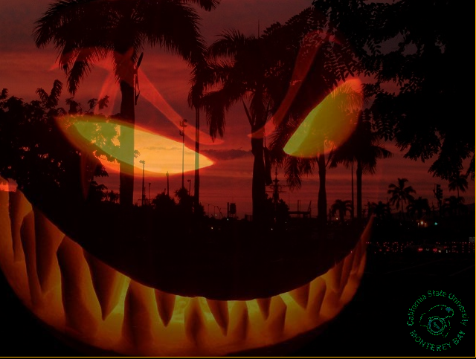
Double-y Filter
The double-y filter allows you to take two pictures and add them together by averaging out each pixel between two pictures. The filter does not require the pictures to be the same size. Whether you are trying to make scary picture or have fun with scenery this filter is sure to provide hours of entertainment.
To use the filter select a picture you would like to modify. Assign the picture to a variable with the command “pic = pickAFile()”. Then run the filter wit h the command “doubley(pic)”. Once the command has been entered you will be prompted to select another picture to add to the original. Every picture includes the CSUMB logo at the bottom right of each image.

